Slide 1
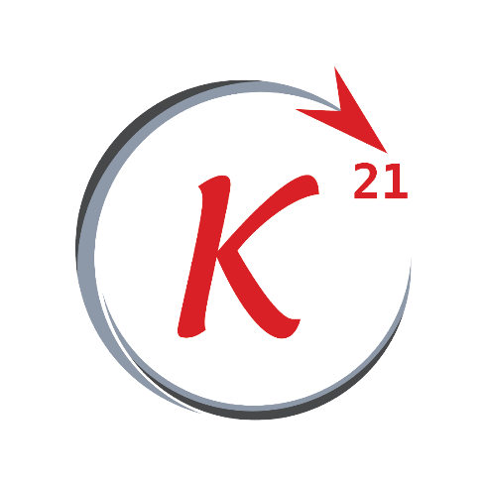
Python Basics

Slide 2
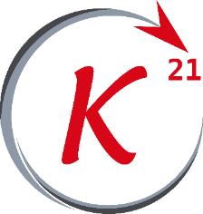
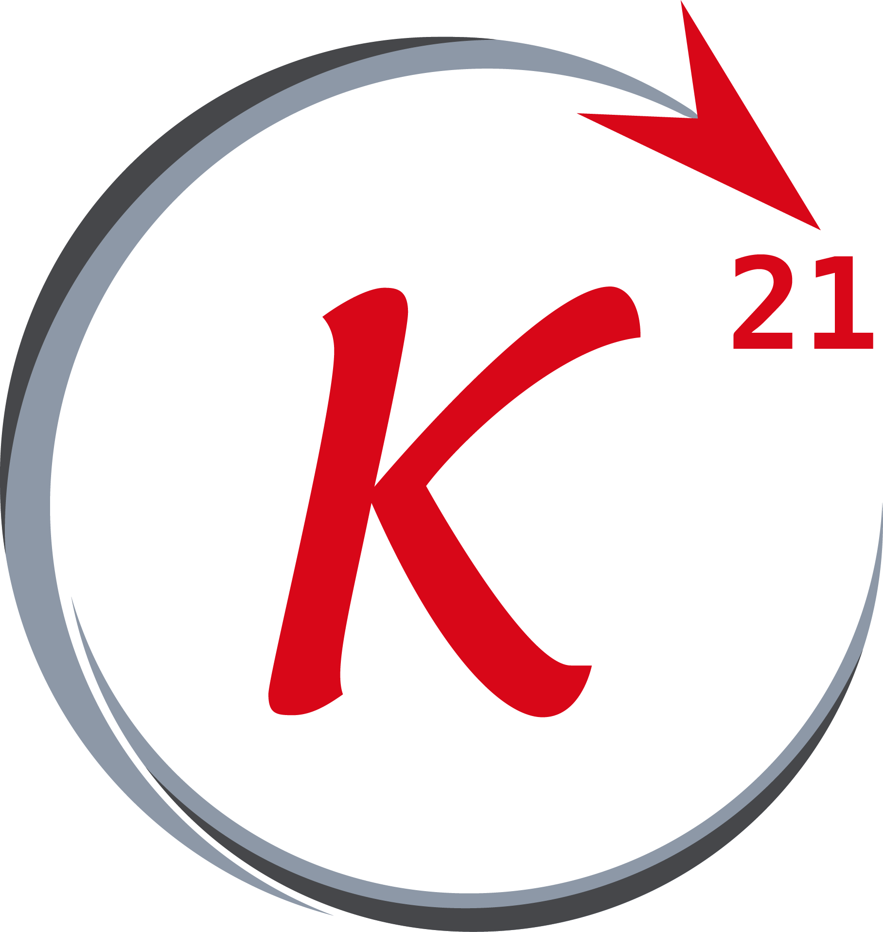


Python
Outline
About python
Installation
Syntax
Logic and execution flow
Functions
Classes
Grow Through

Slide 3
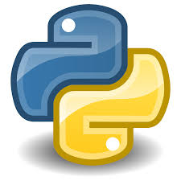
About Python
History
Python is a general-purpose programming language first introduced in 1991 by Guido van Rossum .
With python 2.0 being released in 2000 , and python 3.0 released in 2008 .
It is a high-level and dynamically typed language with garbage-
collection feature .
Python runs on different operating systems including Windows, MacOS,
Linux, Solaris,etc …
Grow Through

Slide 4
About Python
Why Python
GUI applications (Tkinter)
Web applications (www.mathematinu.com)
Automation
Game development
Embedded applications
Data analysis and visualization
Machine learning and artificial intelligence
Grow Through

Slide 5
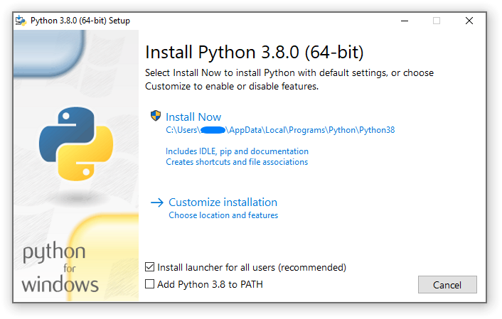
Installation
Python & IDLE
Python can be downloaded from the official website www.python.org .It comes with IDLE, a simple python text editor used to type and edit python files .
We will be using python 3.8.x in this workshop .
Grow Through

Slide 6
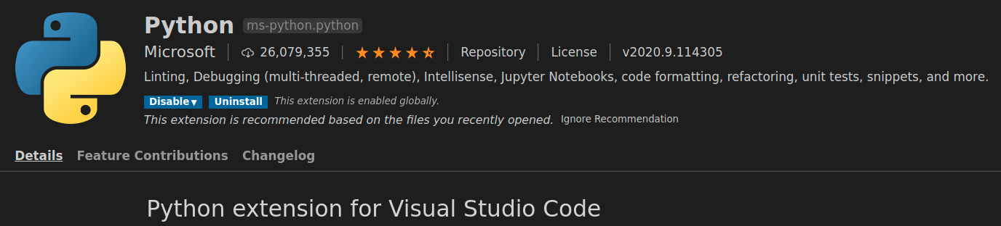
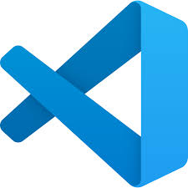
Installation
IDE : VS-Code
A very popular and open-source IDE to use is visual studio code, it has a python extension made and maintained by Microsoft makes writing python code an easy task .
Grow Through

Slide 7
Syntax
Code snippet
Variables, comments, docstrings, indentation
Data Types :
int, float, string, ...
Casting, arithmetic operations
Grow Through

Slide 8
Logic and execution flow
Code snippet
Logic operations :
and, or,not
Conditionals :
equality, inequality, ...
Control flow :
If, else, …
while, for, …
Grow Through

Slide 9
Import
“import” keyword is used to include a python package, module, class, function, etc ... into the current python project so these objects can be called inside the source code .
import “module”
import “module” as “alias”
from “module” import “object”
Grow Through

Slide 10
Functions
Code snippet
def
return
arguments
pass
…
Grow Through

Slide 11
Classes
Code snippet
class
self
__init__
pass
isinstance
Grow Through

Slide 12
Thank You

